Slide 1
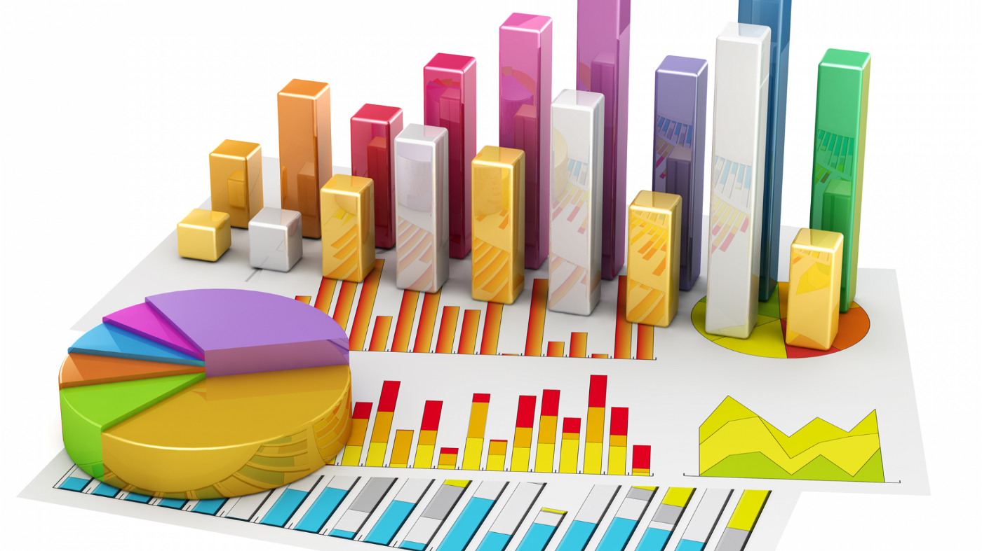
Welcome To….
Chapter 02:
Data Presentation (part 1)

Slide 2
Learning outcomes
Know the appropriate tool for data presentation
Exploring fact from data

Slide 3
Contents
Definition of Frequency Distribution with Examples
Construction of Frequency Distribution for quantitative data
Graphical presentation of quantitative data

Slide 4
Type of Data Presentation
1. Graphical Presentation of Data.
2. Tabular Presentation of Data.
3. Textual Presentation of Data.
Qualitative Variable
Quantitative Variable
Bar chart
Pie Chart
Histogram
Frequency Polygon
Ogive curve
Line graph
Boxplot
Scatter Diagram
Frequency Distribution
Use Words, statements or paragraphs with numbers to present data.

Slide 5
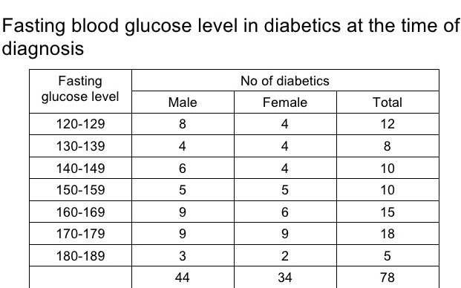
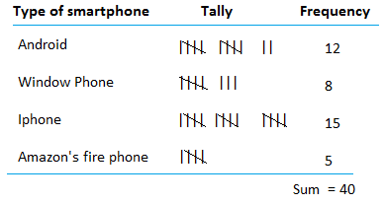
Frequency distribution with Examples
Examples of Frequency Distribution:
for Quantitative data
for Qualitative data
Distribution of Smartphone User

Slide 6
Construction of frequency distribution for quantitative data

Slide 7
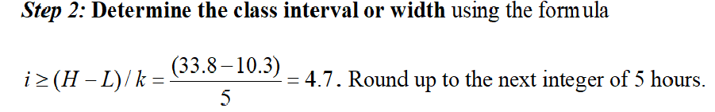
Construction of frequency distribution for quantitative data

Slide 8
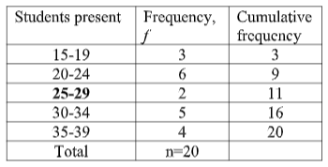
Construction of frequency distribution for quantitative data
This table is just for understanding, not necessary for this math
Upper limit
Lower limit
Example: Inclusive frequency table
Exclusive frequency table
Class interval=
Upper limit-Lower limit=
15-10=5
Class interval=
Upper limit-Lower limit+1=
19-15+1=5

Slide 9
Calculate of Relative, Percentage and Cumulative frequency
Relative frequency = Class Frequency / Total Frequency
Percentage frequency = Relative Frequency *100%
Study Hour | Frequency | Relative Frequency (f_{i} / n) | Percentage Frequency (RF*100%) | Cumulative Frequency
 |  |  |  | Less than | More than
10 – 15 | 7 | 7/30 = 0.233 | 23.3% | 7 | 30
15 – 20 | 12 | 0.400 | 40.0% | 19 | 23
20 – 25 | 7 | 0.233 | 23.3% | 26 | 11
25 – 30 | 3 | 0.100 | 10.0% | 29 | 4
30 – 35 | 1 | 0.033 | 3.3% | 30 | 1
Total | 30
Less than Cumulative frequency =
Pre-class frequency +
Class Frequency
More than Cumulative frequency =
Post-class frequency +
Class Frequency

Slide 10
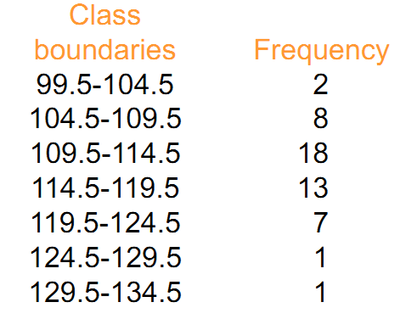
Graphical presentation of frequency distribution for quantitative data
Three types of graphical presentation for quantitative data are:
1.Histogram
2.Frequency Polygon
3. Ogive Curve/ Cumulative Frequency Curve
Draw the following graphs for this temperature data.
Histogram
Frequency Polygon
Ogive Curve/ Cumulative Frequency Curve

Slide 11
Graphical presentation of frequency distribution for quantitative data
From the calculation of the following table we will learn how to draw all the 3 mentioned graphs.
Col-1
Col-2
Col-3
Col-4
Col-5
Col-6
1. Histogram:
Col-1& 2.
2. Frequency polygon:
Col-1, 2 & 5.
3. Less than Ogive curve:
Col-1(upper limits)& col-6.
Lower limits
upper limits

Slide 12
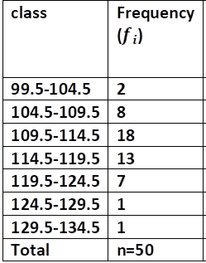
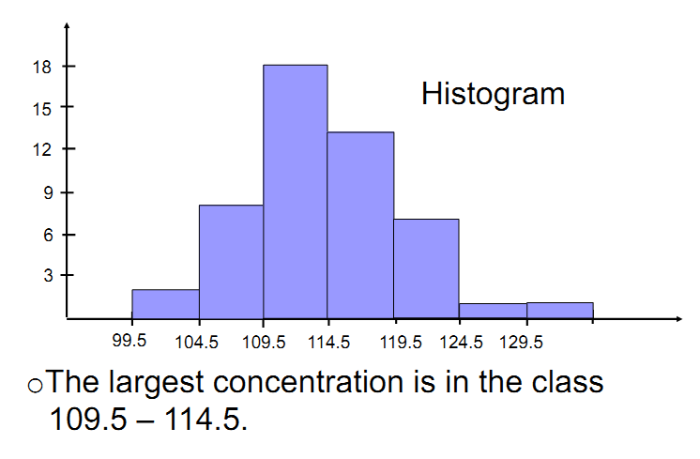
Graphical presentation of frequency distribution for quantitative data

Slide 13
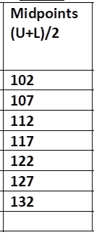
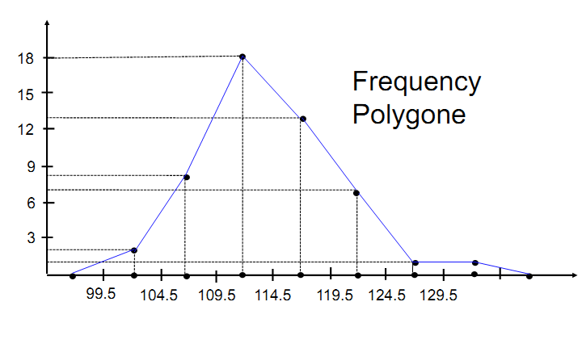
Graphical presentation of frequency distribution for quantitative data

Slide 14
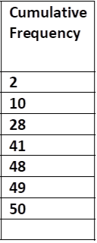
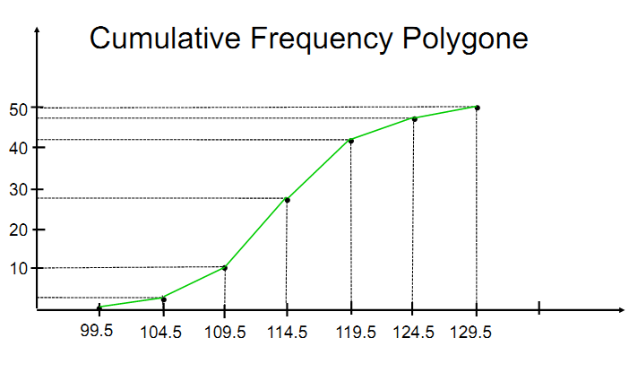
Graphical presentation of frequency distribution for quantitative data

Slide 15
Exercise to solve
The number of walking shoes sold in 20 different shops are given below:
45, 70, 70, 55, 75, 73, 70, 65, 68, 60, 74, 83, 80, 58, 68, 85, 90, 64, 75, 82
Construct a frequency distribution table using appropriate class interval.
Draw Histogram, frequency polygon and ogive curve.
How many shops were able to sold more than 70 shoes?

Slide 16



